Slide 1
Ch 7. Trees
Make Money Fast!
Stock Fraud
Ponzi Scheme
Bank Robbery
Acknowledgement: These slides are adapted from slides provided with Data Structures and Algorithms in C++, Goodrich, Tamassia and Mount (Wiley 2004) and slides from Nancy M. Amato
Notes:
1
1

Slide 2
Outline and Reading
General Trees (Ch. 7.1)
Tree Traversals (Ch. 7.2)
Binary Trees (Ch. 7.3)

Slide 3
What is a Tree
In computer science, a tree is an abstract model of a hierarchical structure
A tree consists of nodes with a parent-child relation
Applications:
Organization charts
File systems
Programming environments
Computers”R”Us
Sales
Manufacturing
R&D
US
International
Laptops
Desktops
Europe
Asia
Canada

Slide 4

Formal Definition
A tree $T$ is a set of nodes storing elements in a parent-child relationship with the following properties:
If $T$ is nonempty, it has a special node called the root of $T$, that has no parent
Each node $v$ of $T$ different from the root has a unique parent node $w$; every node with parent $w$ is a child of $w$
Note that trees can be empty and can be defined recursively!
Note each node can have zero or more children

Slide 5
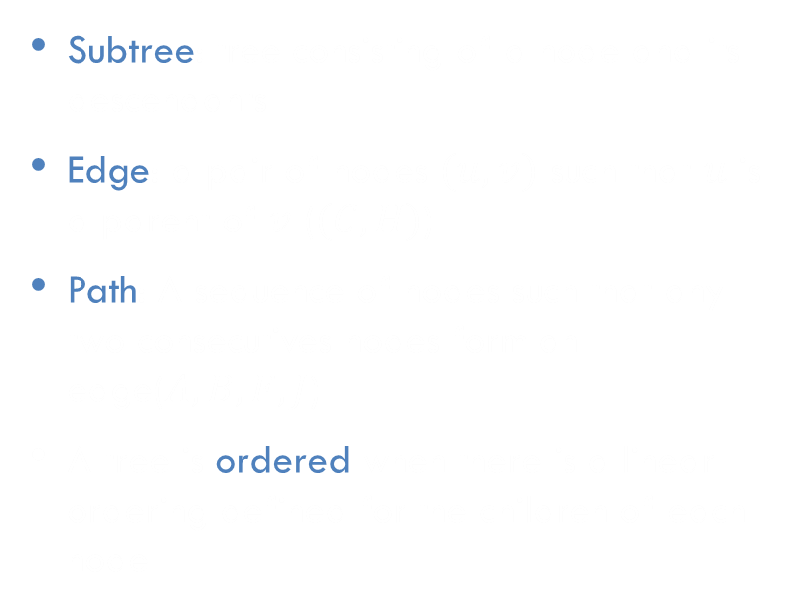
Tree Terminology
Subtree: tree consisting of a node and its descendants
Edge: a pair of nodes $(u, v)$ such that $u$ is a parent of $v$ ($(C, H)$)
Path: A sequence of nodes such that any two consecutives nodes form an edge($A, B, F, J$)
A tree is ordered when there is a linear ordering defined for the children of each node
Root: node without parent (A)
Internal node: node with at least one child (A, B, C, F)
Leaf (aka External node): node without children (E, I, J, K, G, H, D)
Ancestors of a node: parent, grandparent, great-grandparent, etc.
Siblings of a node: Any node which shares a parent
Depth of a node: number of ancestors
Height of a tree: maximum depth of any node (3)
Descendant of a node: child, grandchild, great-grandchild, etc.
A
subtee
B
C
D
E
F
G
H
I
J
K

Slide 6
Exercise
A
Answer the following questions about the tree shown on the right:
What is the size of the tree (number of nodes)?
Classify each node of the tree as a root, leaf, or internal node
List the ancestors of nodes B, F, G, and A. Which are the parents?
List the descendants of nodes B, F, G, and A. Which are the children?
List the depths of nodes B, F, G, and A.
What is the height of the tree?
Draw the subtrees that are rooted at node F and at node K.
B
C
D
E
F
G
H
I
J
K

Slide 7


Tree ADT
We use positions to abstract nodes, as we don’t want to expose the internals of our structure
Position functions:
$p.parent()$ – return parent
$p.children()$ – list of children positions
$p.isRoot()$
$p.isLeaf()$
Tree functions:
$size()$
$empty()$
$root()$ – return position for root
$positions()$ – return list of all positions
Additional functions may be defined by data structures implementing the Tree ADT, e.g., $begin()$ and $end()$

Slide 8
A Linked Structure for General Trees
∅
A node is represented by an object storing
Element
Parent node
Sequence of children nodes
Node objects implement the Position ADT
B
∅
∅
A
D
F
B
A
D
F
∅
∅
C
E
C
E

Slide 9
Preorder Traversal
A traversal visits the nodes of a tree in a systematic manner
In a preorder traversal, a node is visited before its descendants
Application: print a structured document
Algorithm $preOrder(v)$
$visit(v)$
for each child $w$ of $v$
$preOrder(w)$
1
Make Money Fast!
2
5
9
1. Motivations
2. Methods
References
3
4
6
7
8
2.1 Stock Fraud
2.2 Ponzi Scheme
2.3 Bank Robbery
1.1 Greed
1.2 Avidity

Slide 10
Exercise: Preorder Traversal
In a preorder traversal, a node is visited before its descendants
List the nodes of this tree in preorder traversal order.
A
B
C
D
Algorithm $preOrder(v)$
$visit(v)$
for each child $w$ of $v$
$preOrder(w)$
E
F
G
H
I
J
K

Slide 11
Postorder Traversal
In a postorder traversal, a node is visited after its descendants
Application: compute space used by files in a directory and its subdirectories
Algorithm $postOrder(v)$
for each child $w$ of $v$
$postOrder(w)$
$visit(v)$
9
cs16/
8
3
7
homeworks/
programs/
todo.txt 1K
1
2
4
5
6
h1c.doc 3K
h1nc.doc 2K
DDR.java 10K
Stocks.java 25K
Robot.java 20K

Slide 12
Exercise: Postorder Traversal
In a postorder traversal, a node is visited after its descendants
List the nodes of this tree in postorder traversal order.
A
B
C
D
Algorithm $postOrder(v)$
for each child $w$ of $v$
$postOrder(w)$
$visit(v)$
E
F
G
H
I
J
K

Slide 13
Binary Tree
A binary tree is a tree with the following properties:
Each internal node has two children
The children of a node are an ordered pair
We call the children of an internal node left child and right child
If a child has only one child, the tree is improper
Alternative recursive definition: a binary tree is either
a tree consisting of a single node, or
a tree whose root has an ordered pair of children, each of which is a binary tree
Applications
Arithmetic expressions
Decision processes
Searching
A
B
C
D
E
F
G
H
I

Slide 14
Arithmetic Expression Tree
Binary tree associated with an arithmetic expression
Internal nodes: operators
Leaves: operands
Example: arithmetic expression tree for the expression (2 × (a − 1) + (3 × b))
+
×
×
2
−
3
b
a
1

Slide 15
Decision Tree
Binary tree associated with a decision process
Internal nodes: questions with yes/no answer
Leaves: decisions
Example: dining decision
Want a fast meal?
Yes
No
How about coffee?
On expense account?
Yes
No
Yes
No
Starbucks
Spike’s
Al Forno
Café Paragon

Slide 16
Properties of Binary Trees
Notation
$n$ number of nodes
$l$ number of leaves
$i$ number of internal nodes
$h$ height
Properties:
$l=i+1$
$n=2l−1$
$h≤i$
$h≤\frac{n−1}{2}$
$l≤2^{h}$
$h≥\log_{2}{l}$
$h≥\log_{2}\left(n+1\right)−1$

Slide 17

Binary Tree ADT
The Binary Tree ADT extends the Tree ADT, i.e., it inherits all the methods of the Tree ADT
Additional position methods:
$p.left()$
$p.right()$
Update methods may also be defined by data structures implementing the Binary Tree ADT

Slide 18
A Linked Structure for Binary Trees
∅
A node is represented by an object storing
Element
Parent node
Left child node
Right child node
B
∅
∅
B
A
D
A
D
∅
∅
∅
∅
C
E
C
E

Slide 19
Inorder Traversal
In an inorder traversal a node is visited after its left subtree and before its right subtree
Application: draw a binary tree
$x\left(v\right)=$ inorder rank of $v$
$y\left(v\right)=$ depth of $v$
Algorithm $inOrder(v)$
if $v.isInternal()$
$inOrder(v.left())$
$visit(v)$
if $v.isInternal()$
$inOrder(v.right())$
6
2
8
1
4
7
9
3
5

Slide 20
Exercise: Inorder Traversal
In an inorder traversal a node is visited after its left subtree and before its right subtree
List the nodes of this tree in inorder traversal order.
A
Algorithm $inOrder(v)$
if $v.isInternal()$
$inOrder(v.left())$
$visit(v)$
if $v.isInternal()$
$inOrder(v.right())$
B
C
E
F
G
H
I
J

Slide 21
Exercise: Preorder & InOrder Traversal
Draw a (single) binary tree $T$, such that
Each internal node of $T$ stores a single character
A preorder traversal of $T$ yields EXAMFUN
An inorder traversal of $T$ yields MAFXUEN

Slide 22
Application Print Arithmetic Expressions
Specialization of an inorder traversal
print operand or operator when visiting node
print “(“ before traversing left subtree
print “)“ after traversing right subtree
Algorithm $printExpression(v)$
if $v.isInternal()$
$print("(")$
$printExpression(v.left())$
$print(v.element())$
if $v.isInternal()$
$printExpression(v.right())$
$print(")")$
+
×
×
2
−
3
b
a
1
((2 × (a − 1)) + (3 × b))

Slide 23
Application Evaluate Arithmetic Expressions
Specialization of a postorder traversal
recursive method returning the value of a subtree
when visiting an internal node, combine the values of the subtrees
Algorithm $evalExpr(v)$
if $v.isExternal()$
return $v.element()$
$x←evalExpr(v.left())$
$y←evalExpr(v.right())$
$∘ ←$ operator stored at $v$
return $x∘y$
+
×
×
2
−
3
2
5
1

Slide 24
Exercise Arithmetic Expressions
Draw an expression tree that has
Four leaves, storing the values 1, 5, 6, and 7
3 internal nodes, storing operations +, -, *, / operators can be used more than once, but each internal node stores only one
The value of the root is 21

Slide 25
Euler Tour Traversal
Generic traversal of a binary tree
Includes as special cases the preorder, postorder and inorder traversals
Walk around the tree and visit each node three times:
on the left (preorder)
from below (inorder)
on the right (postorder)
+
L
×
R
×
B
2
−
3
2
5
1

Slide 26
Euler Tour Traversal
Algorithm $eulerTour(v)$
$left_visit(v)$
if v$.isInternal()$
$eulerTour(v.left())$
$bottom_visit(v)$
if $v.isInternal()$
$eulerTour(v.right())$
$right_visit(v)$
+
L
×
R
×
B
2
−
3
2
5
1

Slide 27
Application Print Arithmetic Expressions
Specialization of an Euler Tour traversal
Left-visit: if node is internal, print “(”
Bottom-visit: print value or operator stored at node
Right-visit: if node is internal, print “)”
Algorithm $printExpression(v)$
if $v.isExternal()$
print $v.element()$
else
print “(”
$printExpression(v.left())$
print operator at $v$
$printExpression(v.right())$
print “)”
+
×
×
2
−
3
b
a
1
((2 × (a − 1)) + (3 × b))

Slide 28
Interview Question 1
Implement a function to check if a binary tree is balanced. For the purposes of this question, a balanced tree is defined to be a tree such that the heights of the two subtrees of any node never differ by more than one.

Slide 29
Interview Question 2
Given a binary tree, design an algorithm which creates a linked list of all the nodes at each depth (e.g. , if you have a tree with depth D, you'll have D linked lists).

